Slide 1

WHAT NUMBER SAYS??
Developed By:
Manjeet Thadani

Slide 2
Functionalities
Random Facts API -
API selects a random number and returns a fact related to that category.
For eg: http://numbersapi.com/random/math will return a random fact related to mathematics.
Specific Facts API -
This returns a fact related to number related to that category. For eg: http://numbersapi.com/3/math will return a fact related to number "3" for category "math"

Slide 3
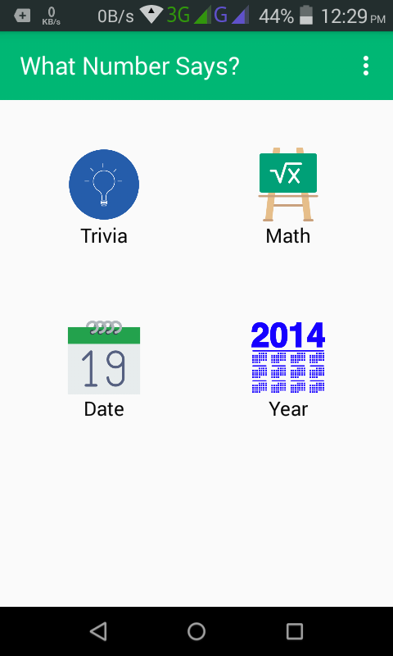
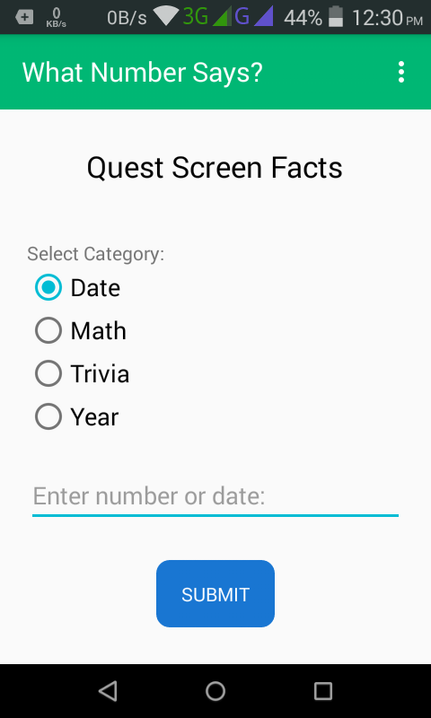
Working:-
Random Facts Screen--
Quest Facts Screen--

Slide 4
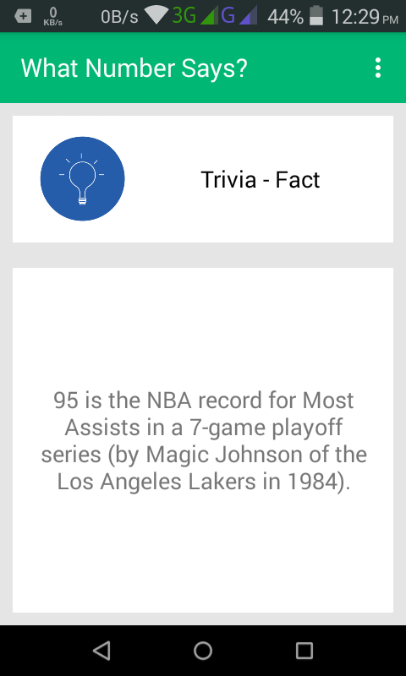
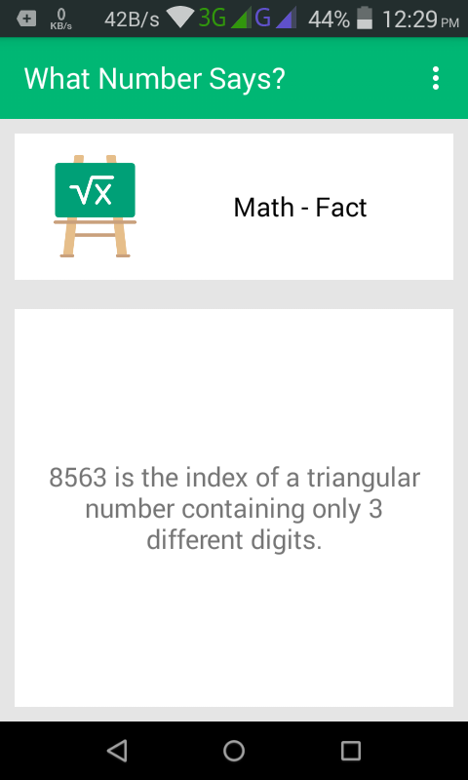
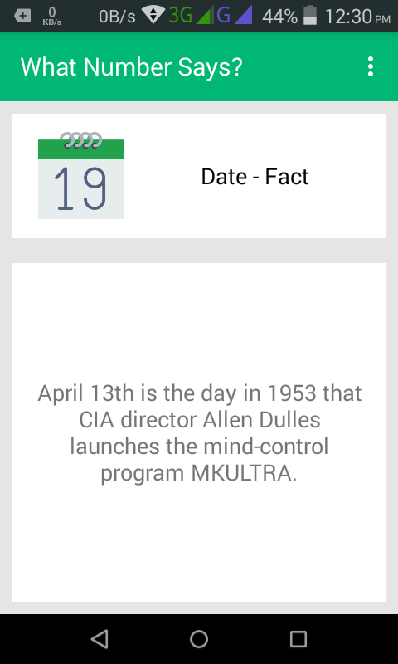
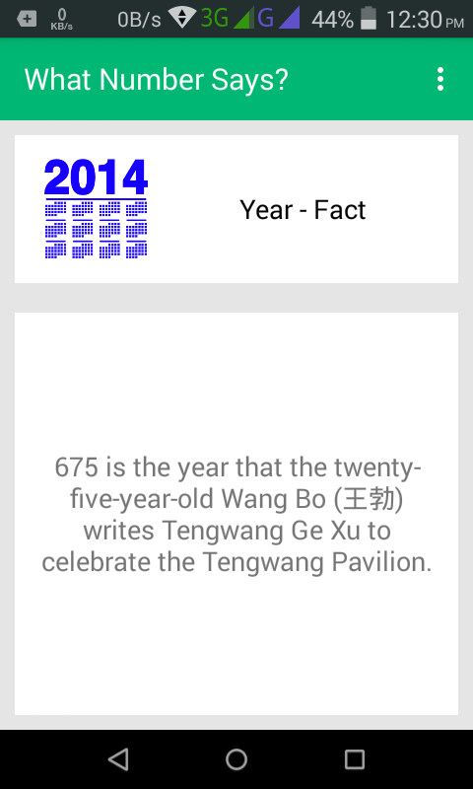
Some Random Facts--

Slide 5
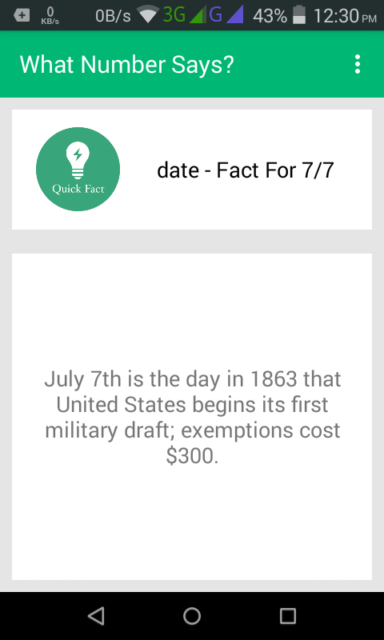
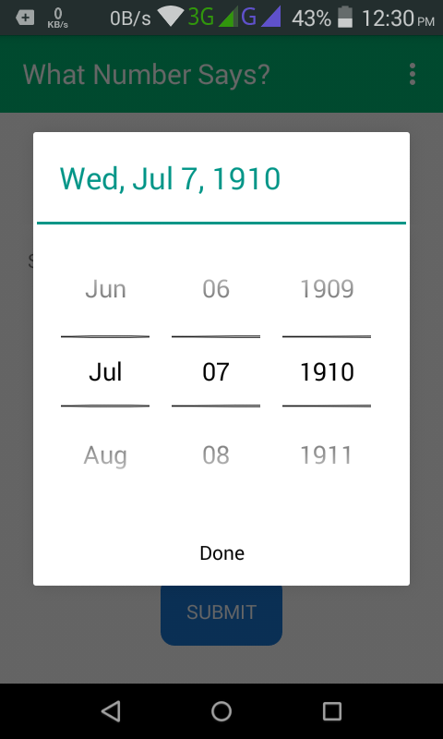
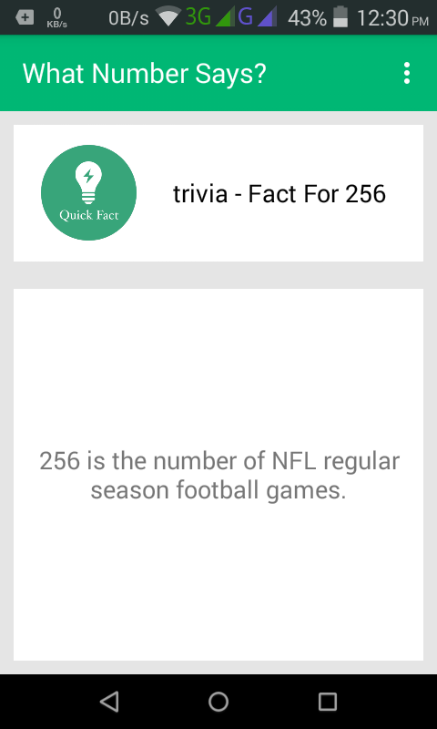
Some Quest Facts--

Slide 6
THANK YOU

